Slide 1
Project Development System
Presented By: Aswathy P Roll no:15
Project Guide:
Ms. Gloria Mathew

Slide 2
Introduction
Project Development System allows all participants to share ideas, documents and allows to enter, distribute and track all tasks required to reach a common objective from any browser, anywhere in the world and at any time of the day.
The objective of the system is providing a web application for a software company for supporting the planning of human resources and project management.
The system supports the process of associating tasks to the right employees in a way that due dates are met while every employee gets a constant workload and also the work of each of the employee can be analyzed efficiently.

Slide 3
MODULES
There are five users in this project:
1.Administrator
2.Project Manager
3.Team Leader
4. Employees
5. Clients

Slide 4
1.Administrator
Managing project managers, projects and client interaction.
Add, edit or delete project managers
View reports from project manager
assign a project to the project managers.
2.Project Manager
Add team leaders and employees to a particular project.
Assign a project or part of the project to a particular team leader or group of team leaders under his team.
Collect the status and details of the projects
He can view reports from the team leader about various stages or phases of a project assigned to the team leader.

Slide 5
3.Team Leader
Managing a fixed number of employees assigned to his team for the successful completion of a project.
Divide the project into different modules and he can assign each module to the employees.
View reports and status of the work done by the employees
Manage the time allotted for each employee to complete the task.
Dashboard facility to team leaders through which they can view the tickets and milestones of each and every employee in his team.
Request project manager to add new employees into the team if needed

Slide 6
4. Employees
Employees can view the different tasks or modules in a project assigned to him by the team leader.
View the time allotted for a particular task
See a track record of his completed as well as incomplete works.
option to update their work status also.
5. Clients
View the status of their project
Settle their invoices, can inform the administrator about the modifications required in his project etc.
See the development of his project through a dashboard system in which his project is divided into different modules.
It will also show the completed task in each module and incomplete tasks in the project.

Slide 7
Table Design
1.Table name: login
Primary key: username
Field | Type | Length | Constraint | Description
loginid | int | 6 | notnull | Automatically incremented id
role | varchar | 20 | not null | Type of user
username | varchar | 20 | primarykey | Username of user
password | varchar | 20 | not null | Password of user
status | varchar | 20 | notnull | Block or unblock status
online | int | 6 | not null | Online user status

Slide 8
2.Table name: manager
Primary key: mgrid
Foreign key: username
Field | Type | Length | Constraint | Description
mgrid | Int | 6 | primarykey | Automatically incremented id
mgrname | Varchar | 20 | notnull | Name of manager
mgrdomain | Varchar | 20 | notnull | Associated domains
username | Varchar | 20 | foreignkey | Username of manager
mgrphoto | Varchar | 100 | not null | Photo path of manager
mgrresume | Varchar | 100 | notnull | Resume path of manager
mgrexp | Varchar | 10 | not null | Experience of manager
mgrdate | Date |  | notnull | Appointed date of manager
mgremail | Varchar | 20 | not null | Email-id of manager

Slide 9
3.Table name: team leader
Primary key: teamid
Foreign key: username
Field | Type | Length | Constraint | Description
teamid | Int | 6 | primarykey | Automatically incremented id
teamname | Varchar | 20 | notnull | Name of team leader
team domain | Varchar | 20 | not null | Associated domains
username | Varchar | 20 | foreignkey | Username of team leader
team photo | Varchar | 100 | not null | Photo path of team leader
team resume | Varchar | 100 | notnull | Resume path of team leader
team exp | Varchar | 10 | notnull | Experience of team leader
team date | Date |  | notnull | Appointed date of team leader
team email | Varchar | 20 | not null | Email-id of team leader

Slide 10
4.Table name: employee
Primary key : empid
Foreign key: teamid, mgrid, username
Field | Type | Length | Constraint | Description
empid | Int | 6 | primarykey | Automatically incremented id
teamid | Varchar | 20 | foreignkey | Unique id of team leader
empname | Varchar | 20 | notnull | Name of employee
mgrid | Varchar | 20 | foreignkey | Code of manager
username | Varchar | 20 | foreignkey | Username of employee
empphoto | Varchar | 100 | notnull | Photo path of employee
empresume | Varchar | 100 | notnull | Resume path of employee
empexp | Varchar | 20 | notnull | Experience of employee
empdate | Date | 20 | notnull | Appointed date of employee
empemail | varchar | 20 | not null | Email-id of employee
empproject | varchar | 50 | notnull | Project assigned for the employee

Slide 11
5.Table name: client
Primary key : clid
Foreign key: username
Field | Type | Length | Constraint | Description
clid | Int | 6 | primarykey | Automatically incremented id
clname | varchar | 20 | notnull | Name of client
cloccu | varchar | 20 | notnull | Occupation of client
claddrs | varchar | 50 | notnull | Address of client
clage | int | 3 | notnull | Age of client
clgen | varchar | 3 | notnull | Gender of client
username | varchar | 20 | foreignkey | Username of client
clemail | varchar | 20 | notnull | Email-id of client
clphone | varchar | 20 | notnull | Phone number of client
cldescr | varchar | 50 | notnull | Description of work

Slide 12
6.Table name: adminwork
Primary key :aworkid
Foreign key: username
Field | Type | Length | Constraint | Description
aworkid | int | 6 | primarykey | Automatically incremented id
username | int | 6 | foreignkey | Id of user
projecttopic | varchar | 50 | not null | Topic of project
project | varchar | 500 | notnull | Path of project abstract file
extra | varchar | 100 | notnull | Extra information
enddate | date |  | notnull | Date of completion given by user
workstatus | varchar | 20 | notnull | Status of work
Status | varchar | 20 | not null | Current status

Slide 13
7.Table name: managerwork
Primary key: mworkid
Foreign key: Mgrid
Field | Type | Length | constraint | Description
mworkid | int | 6 | primarykey | Automatically incremented id
mgrid | int | 20 | foreignkey | Code of manager
projecttopic | varchar | 50 | notnull | Topic of project
project | varchar | 500 | notnull | Path of project abstract file
extra | varchar | 50 | notnull | Extra information
completion date | date |  | not null | Date of completion assigned by admin
end date | date |  | notnull | Actually completed date
workstatus | varchar | 20 | notnull | Status of work
status | varchar | 20 | notnull | Current status

Slide 14
8.Table name: teamwork
Primary key: tworkid
Foreign key: teamid
Field | Type | Length | constraint | Description
tworkid | int | 6 | primarykey | Automatically incremented id
teamid | int | 20 | foreignkey | Code of teamleader
projecttopic | varchar | 50 | notnull | Topic of project
project | varchar | 500 | notnull | Path of project abstract file
extra | varchar | 100 | not null | Extra information
completion date | date |  | notnull | Date of completion assigned by admin
end date | date |  | notnull | Actually completed date
workstatus | varchar | 20 | notnull | Status of work
status | varchar | 20 | notnull | Current status

Slide 15
9.Table name: news
Field | Type | Length | constraint | Description
news | varchar | 100 | notnull | News data

Slide 16
10.Table name: inbox
Primary key : inboxid
Foreign key: toid, fromid
Field | Type | Length | Constraint | Description
inboxid | int | 6 | primarykey | Automaticaly incremented id
toid | varchar | 20 | foreignkey | Id of receiver
fromid | varchar | 20 | foreignkey | Id of sender
subject | varchar | 50 | notnull | Subject of message
message | varchar | 500 | not null | Content of message
Field | Type | Length | Constraint | Description

Slide 17
11.Table name: sentitems
Primary key: sendid
Foreign key: fromid, toid
Field | Type | Length | constraint | Description
sendid | int | 6 | primarykey | Automaticaly incremented id
fromid | varchar | 20 | foreignkey | Id of receiver
toid | varchar | 20 | foreignkey | Id of sender
subject | varchar | 50 | notnull | Subject of message
message | varchar | 500 | notnull | Content of message
Field | Type | Length | Constraint | Description

Slide 18
12.Table name: chat
Primary key: sendid
Foreign key: from, to
Field | Type | Length | constraint | Description
id | int | 6 | primarykey | Automatically incremented id
from | varchar | 20 | foreignkey | Sender
to | varchar | 20 | foreignkey | Receiver
message | text |  | notnull | Content
sent | datetime |  | notnull | Send message
recd | int | 10 | notnull | Record of message

Slide 19
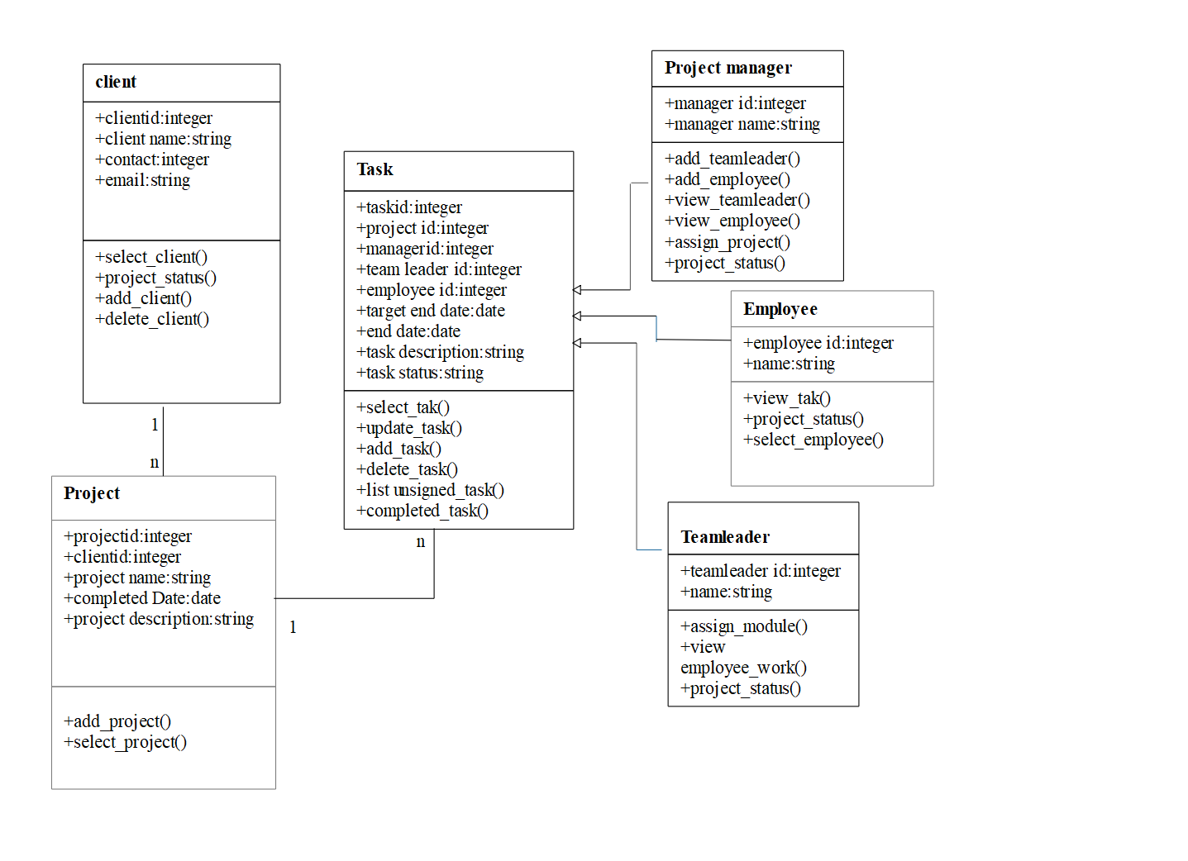
UML DIAGRAMS
CLASS DAIGRAM

Slide 20
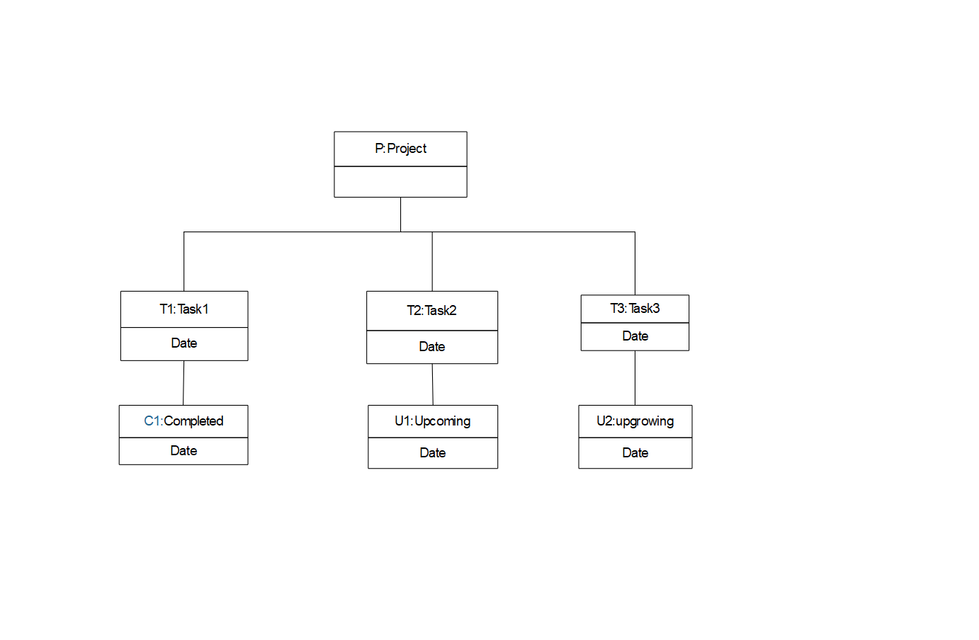
OBJECT DIAGRAM

Slide 21
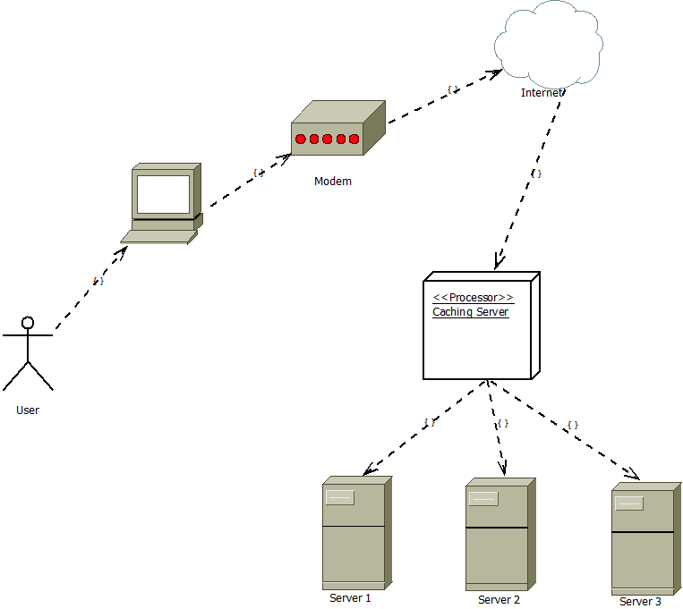
DEPLOYMENT DIAGRAM

Slide 22
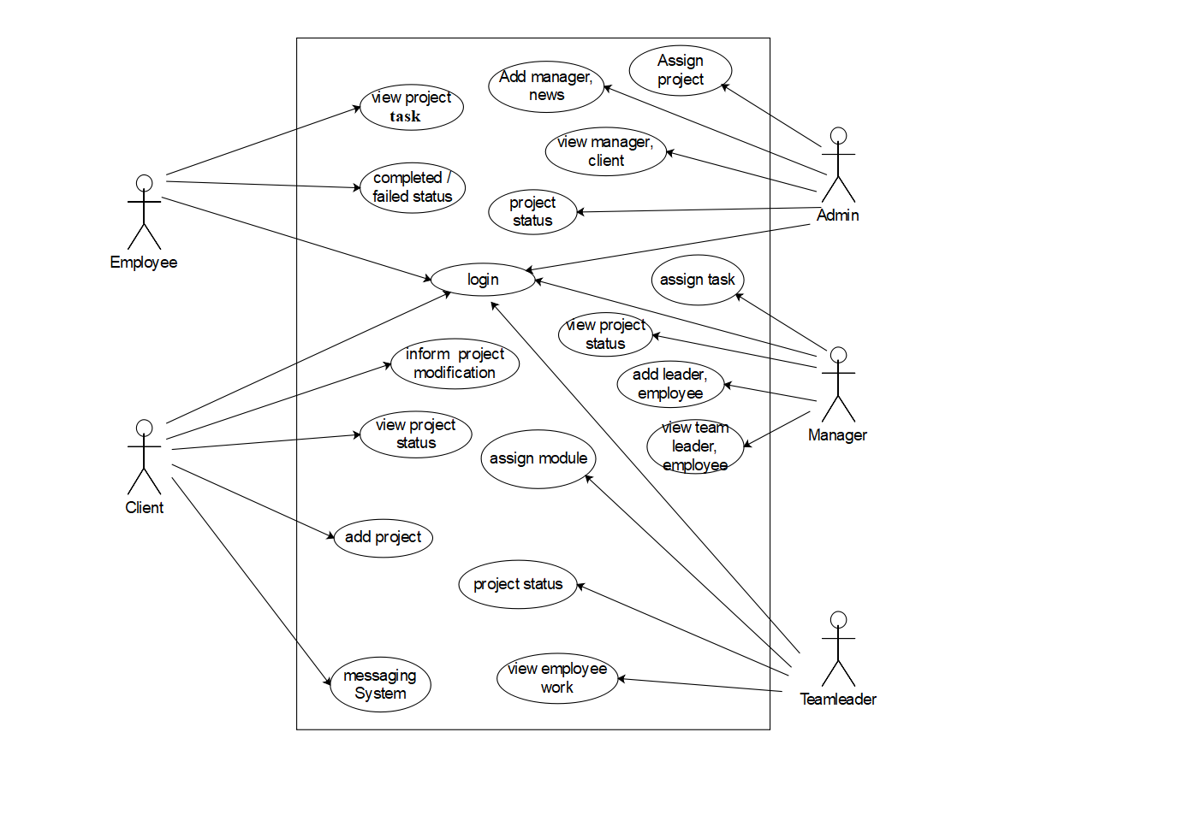
BEHAVIOUR DIAGRAM -USECASE:

Slide 23
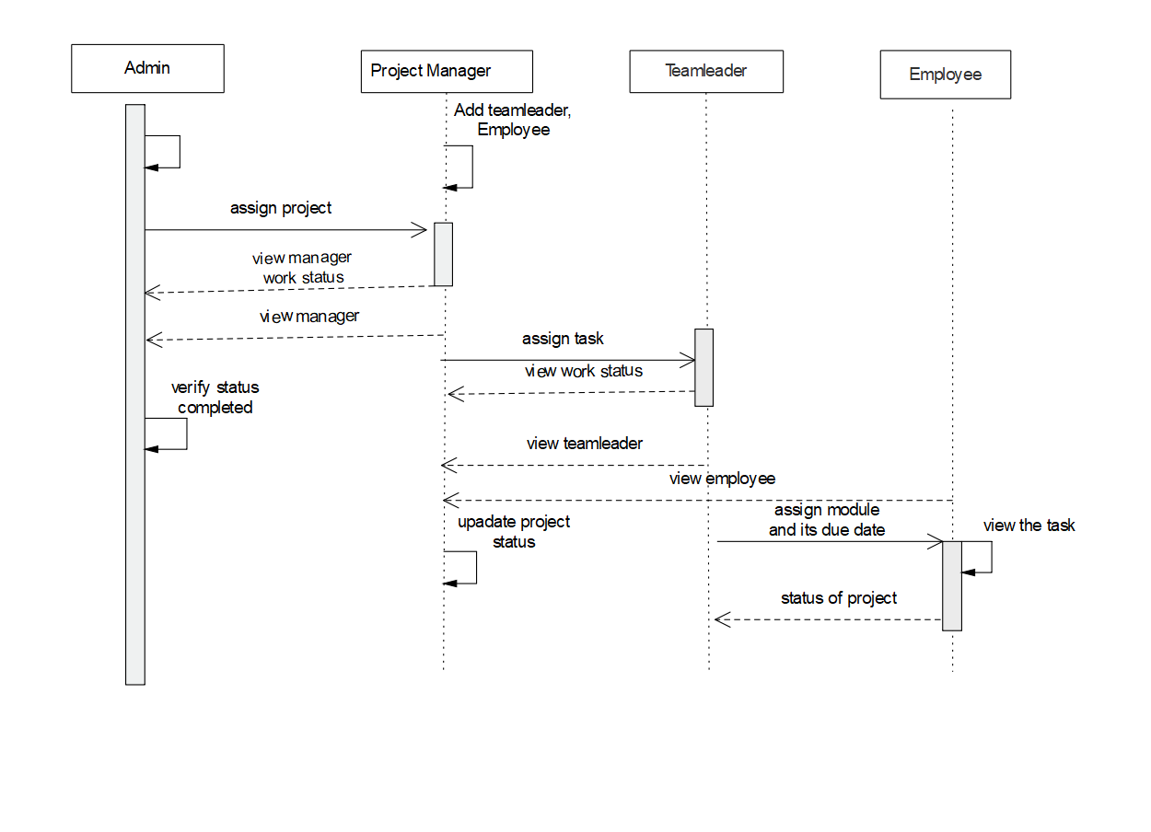
SEQUENCE DIAGRAM

Slide 24
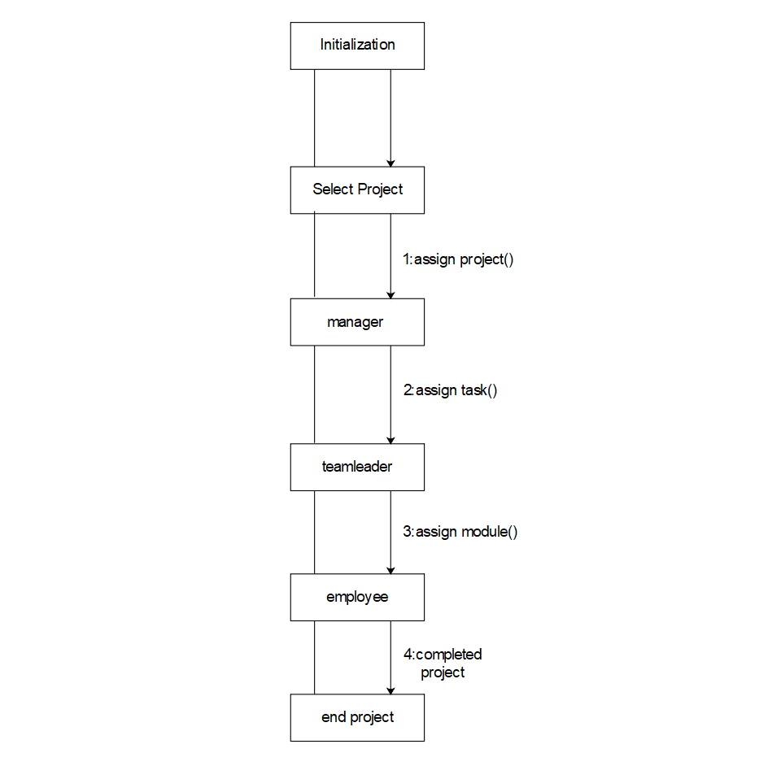
COLLABORATION DIAGRAM

Slide 25
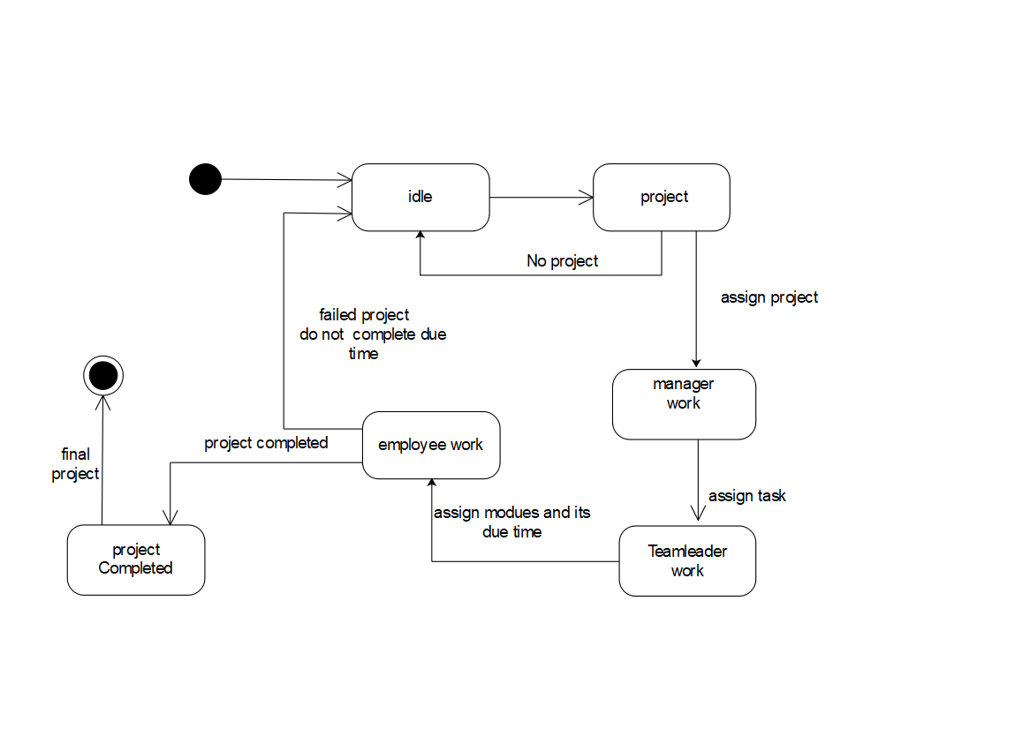
STATECHART DIAGRAM

Slide 26
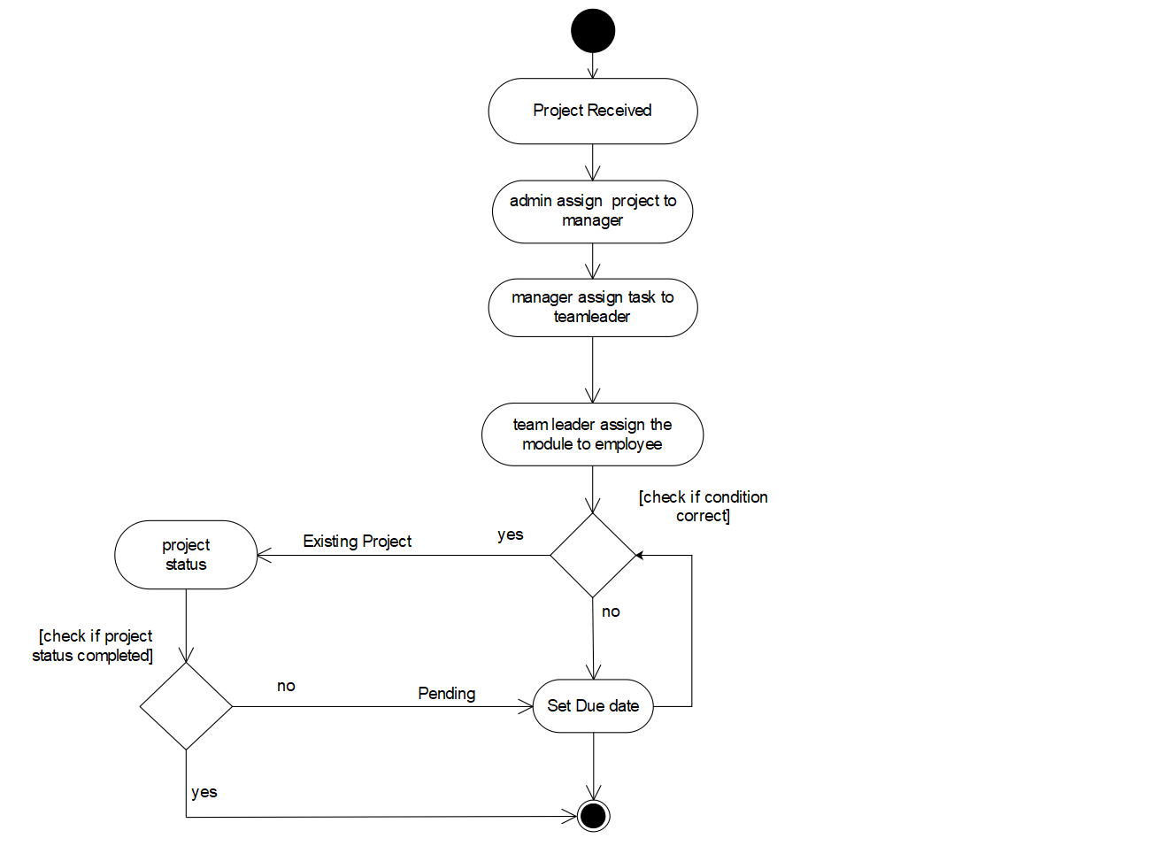
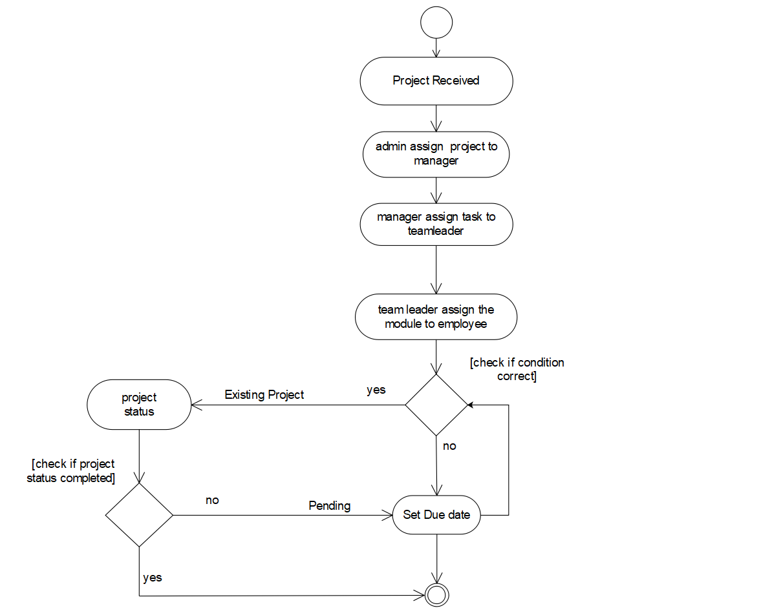
ACTIVITY DIAGRAM

Slide 27

FORM DESIGN
Home Page

Slide 28
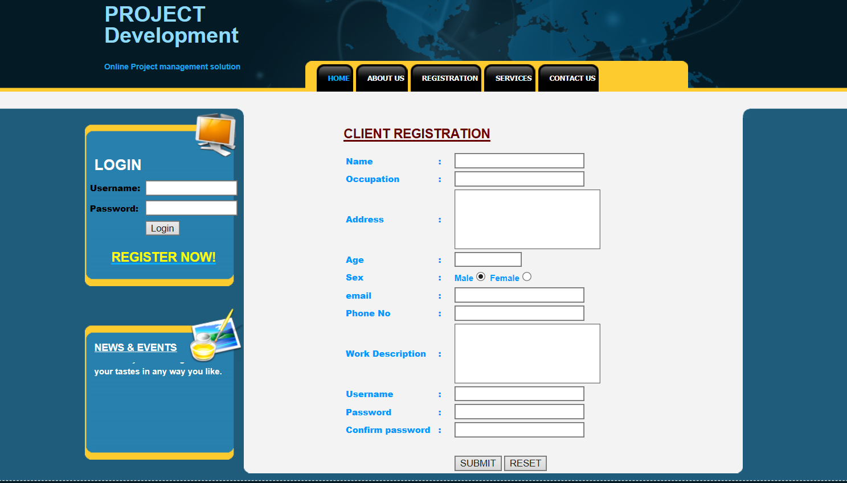
Client Registration

Slide 29
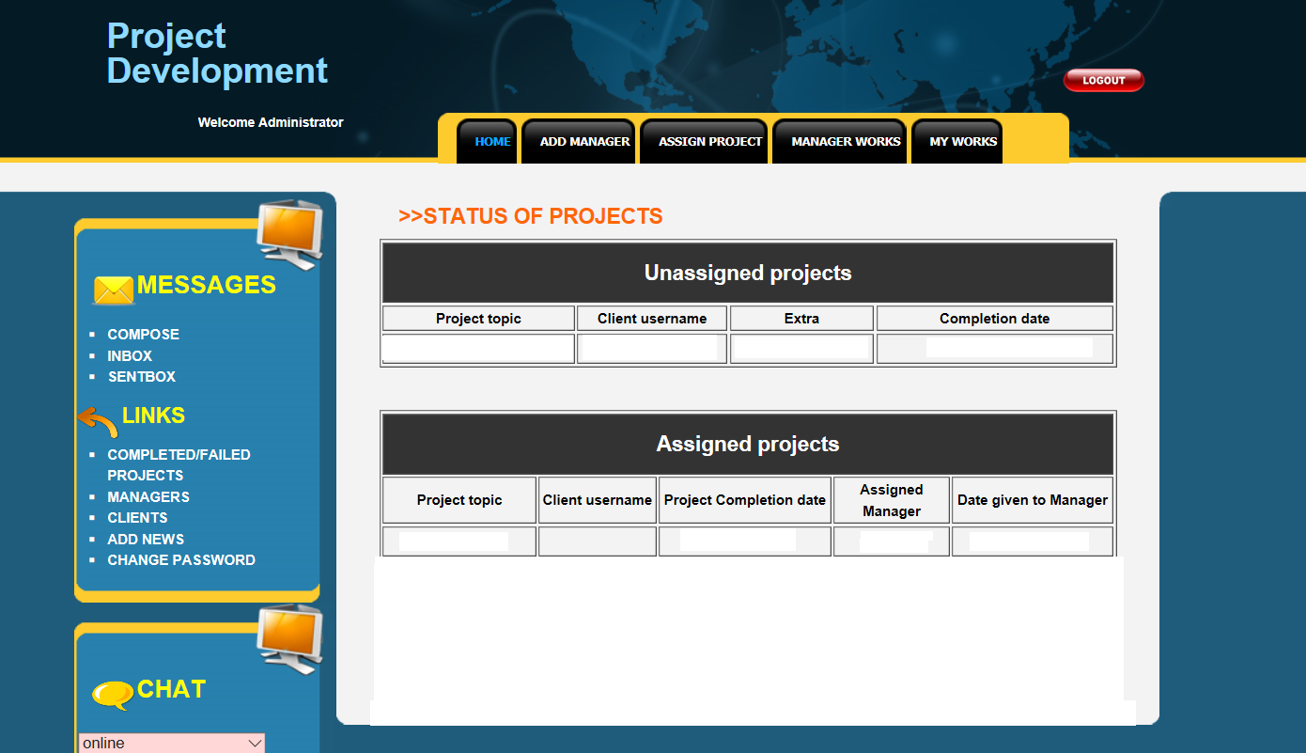
Admin Home

Slide 30
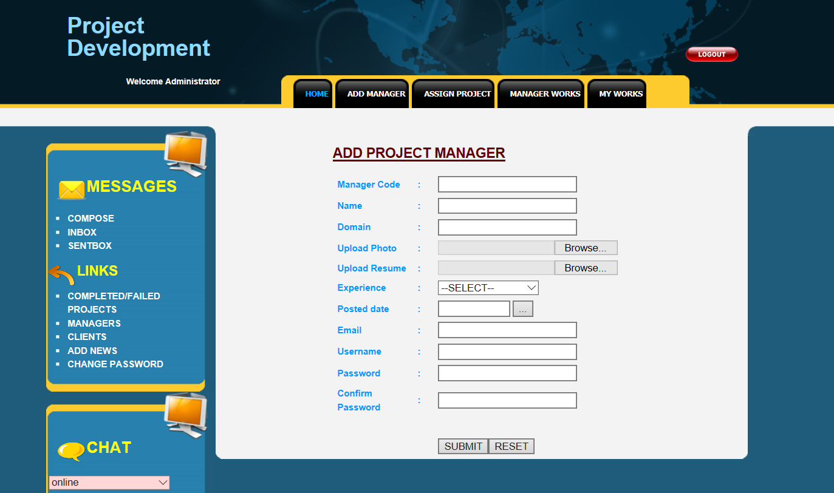
Add Project

Slide 31
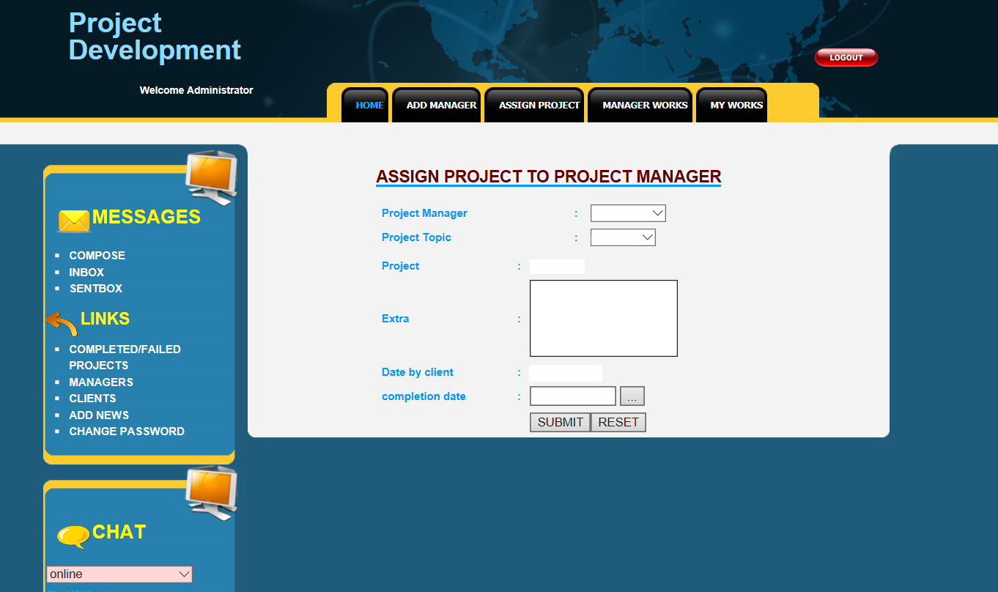
Assign Project

Slide 32
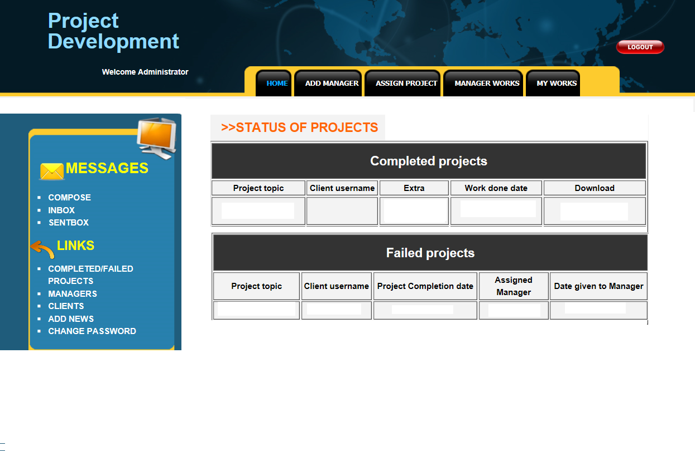
Completed/Failed Project

Slide 33
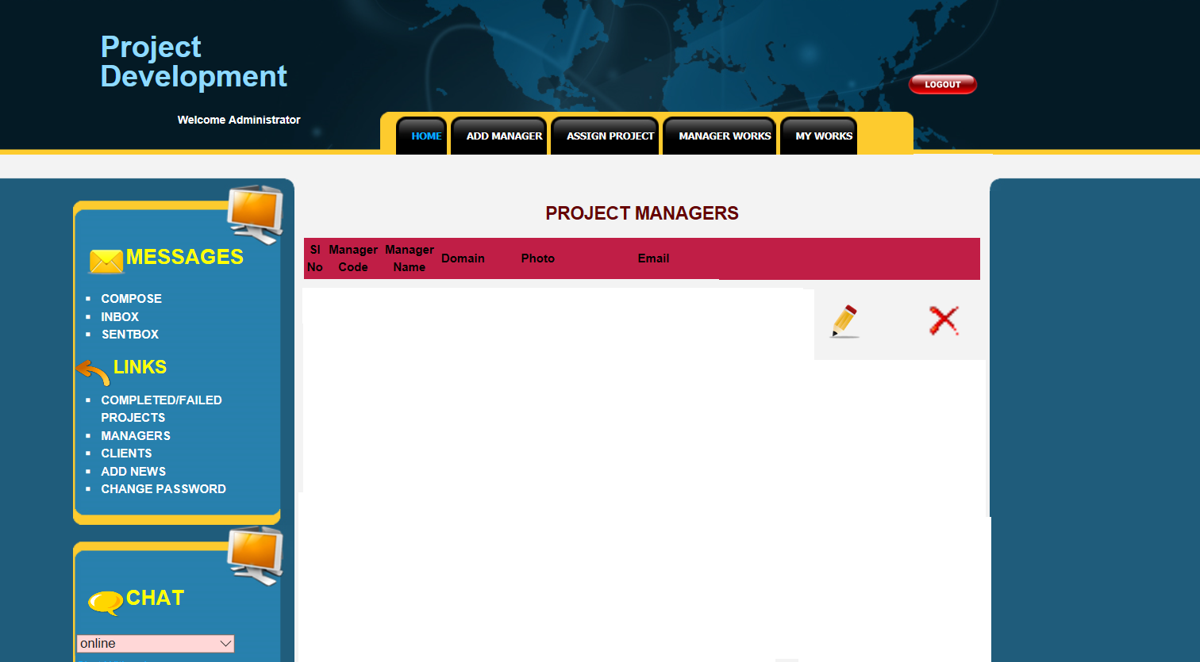
Manager View

Slide 34
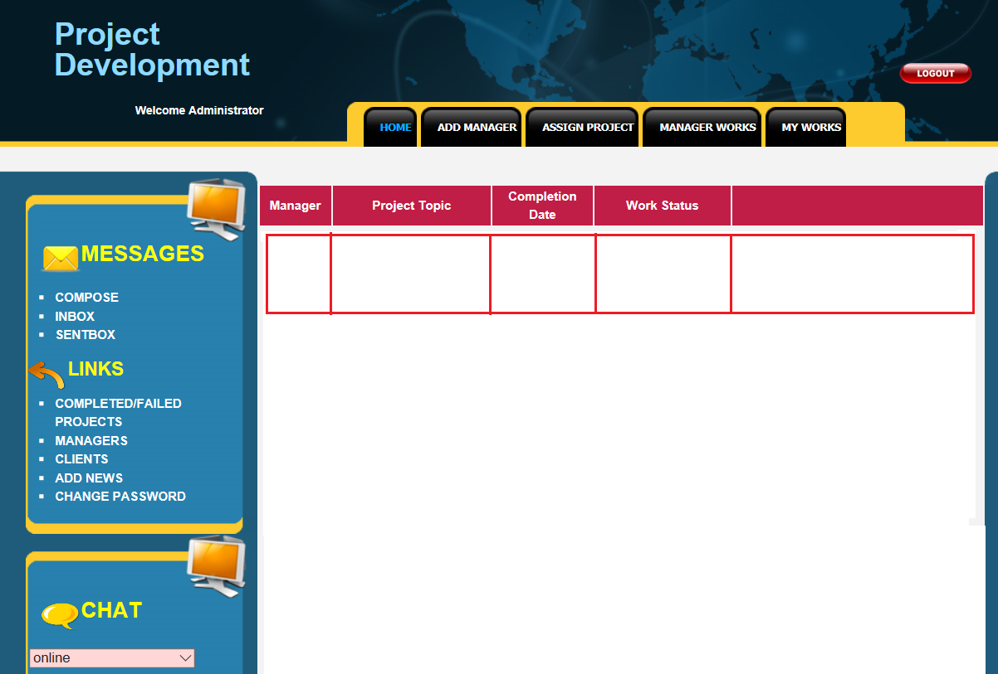
Manager Work View

Slide 35
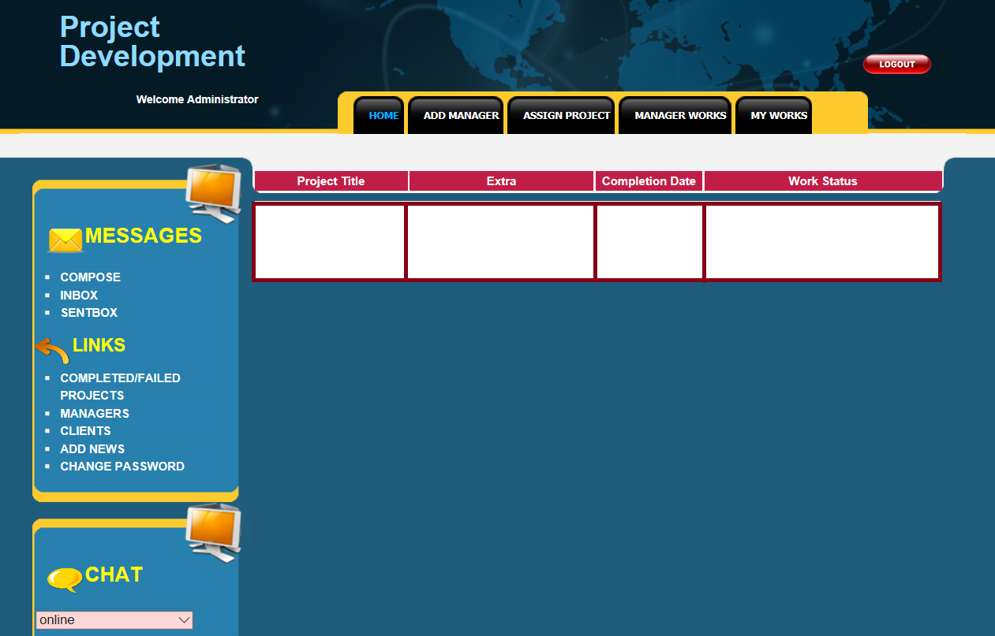
Admin Work

Slide 36
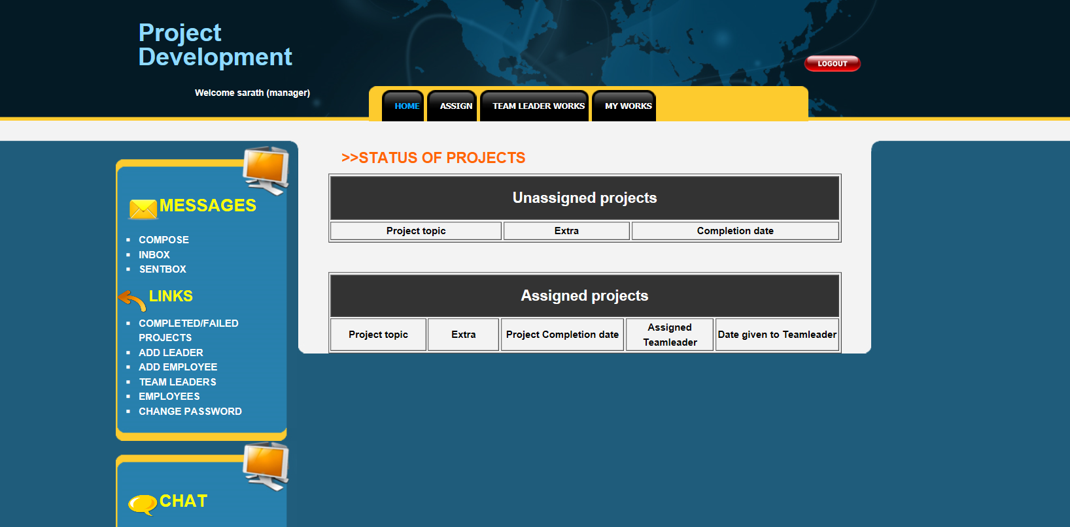
Manager Home

Slide 37
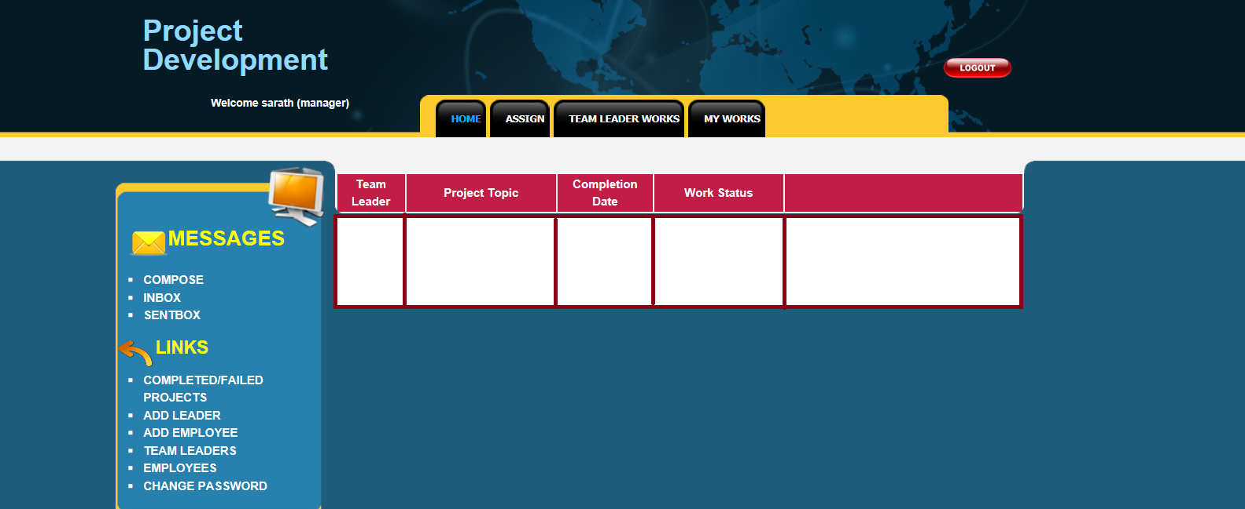
Team leader Work View

Slide 38
Team Leader View

Slide 39
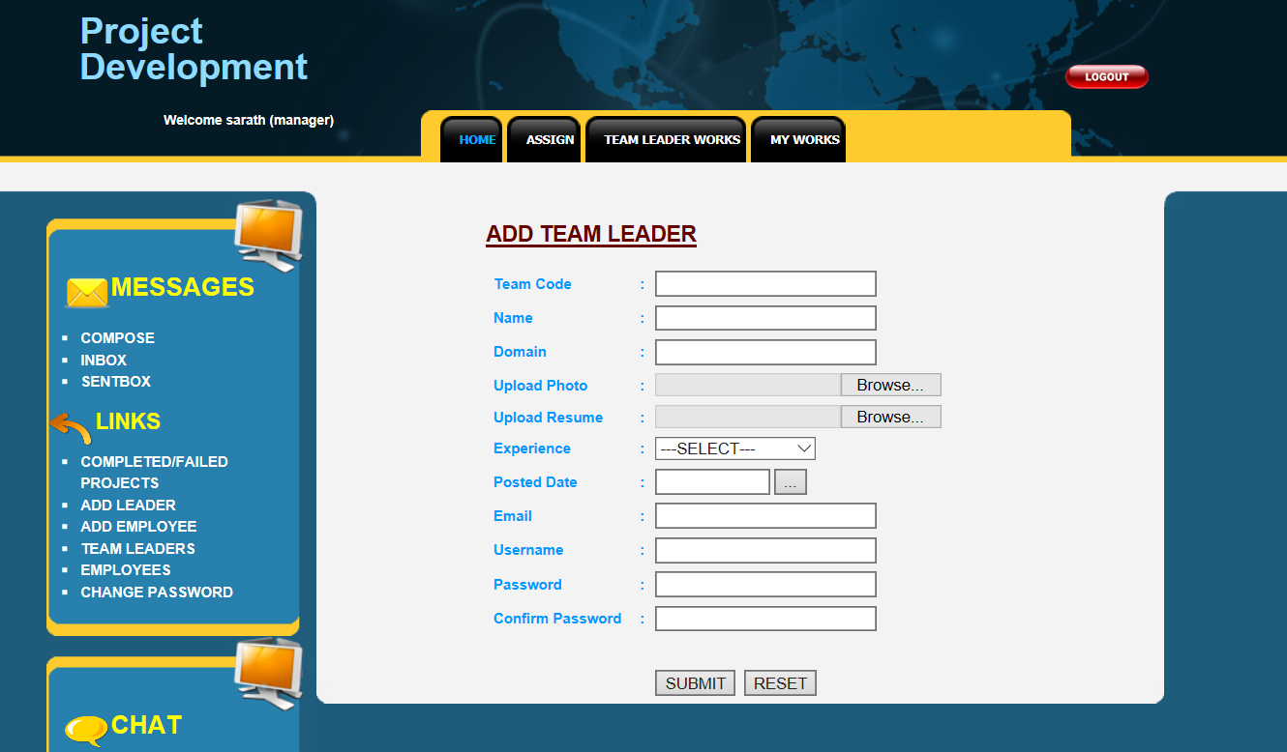
Add Team leader

Slide 40
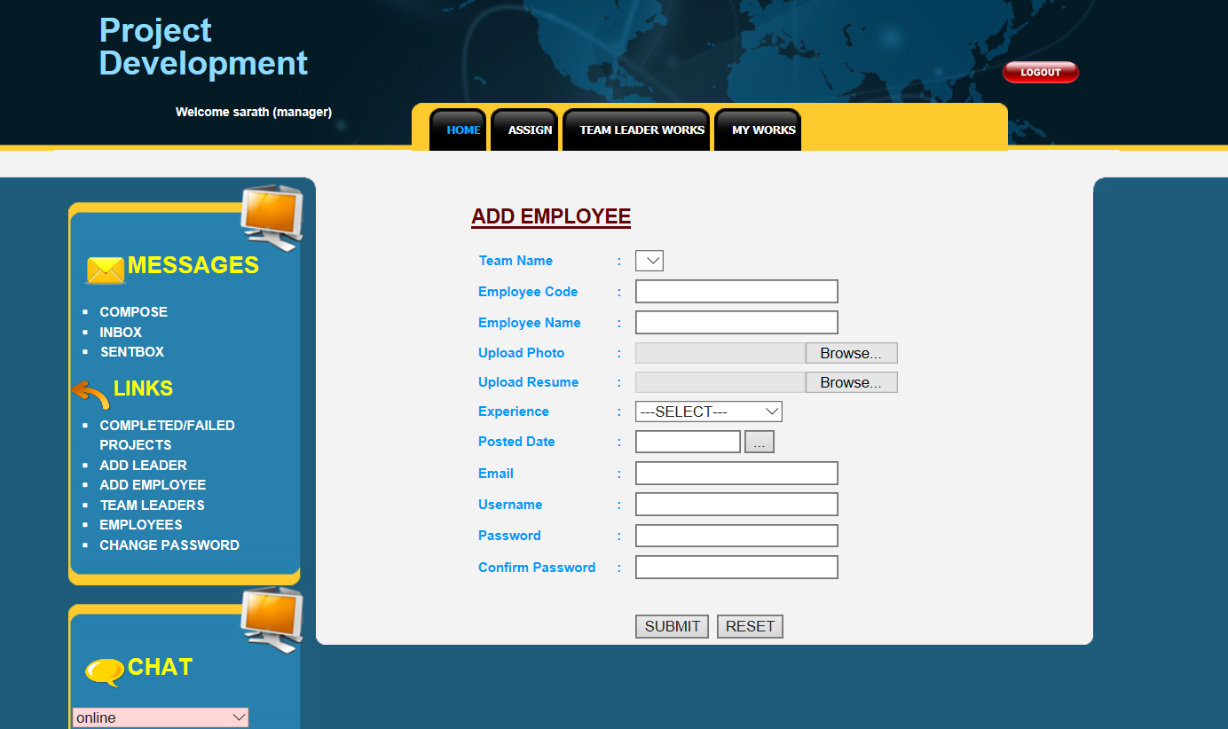
Add Employee

Slide 41

Client Home

Slide 42
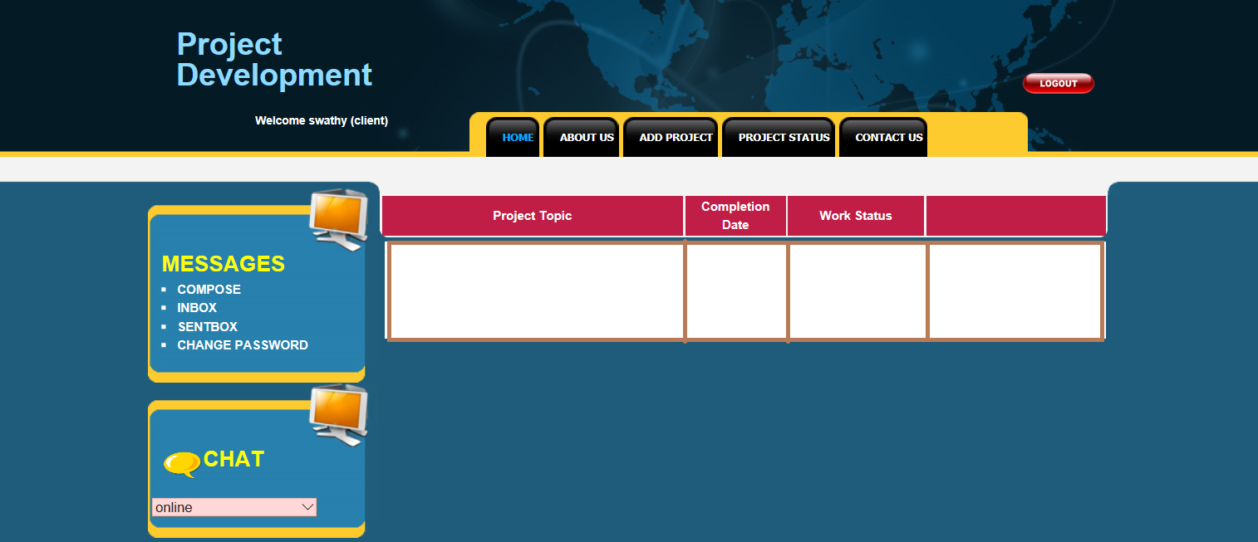
Add Project

Slide 43
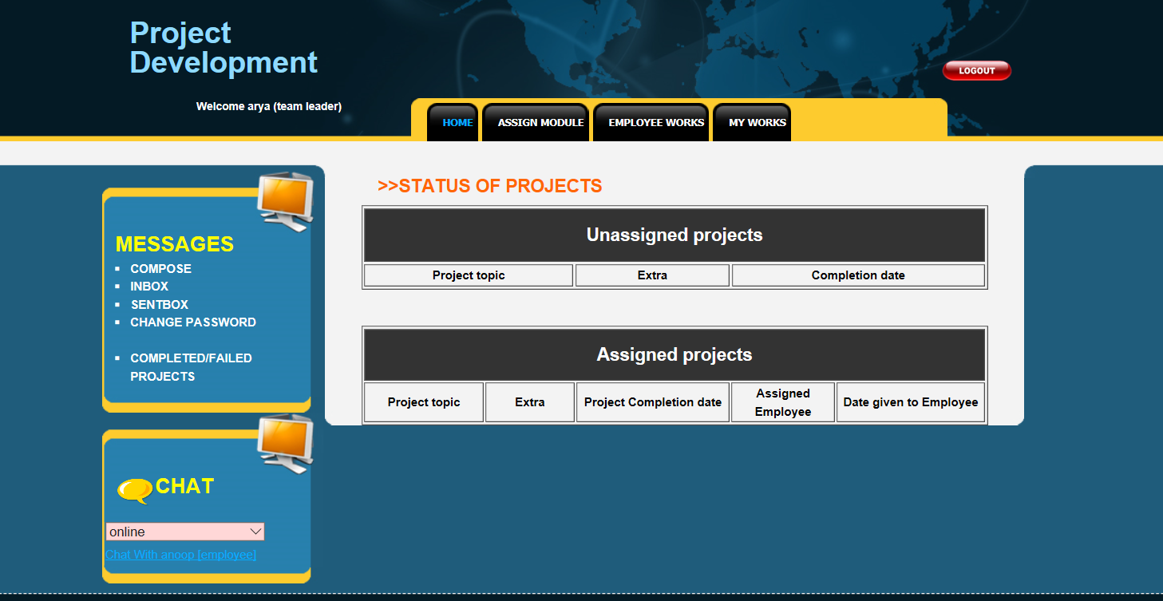
Team Leader Home

Slide 44
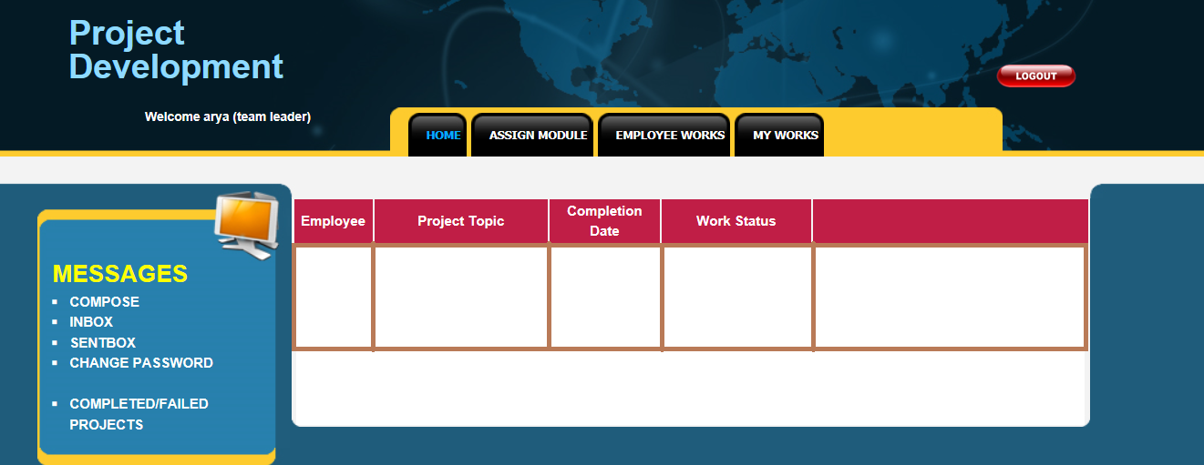
Employee Work View

Slide 45
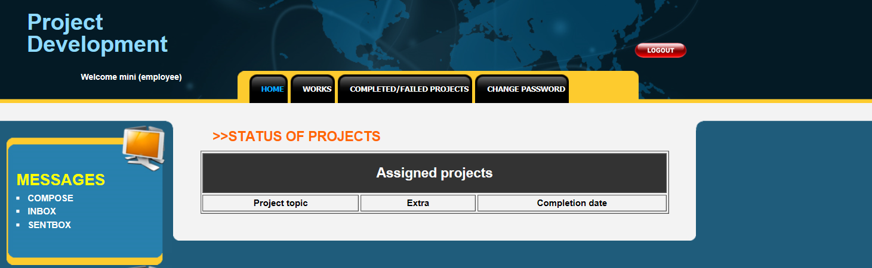
Employee Home

Slide 46
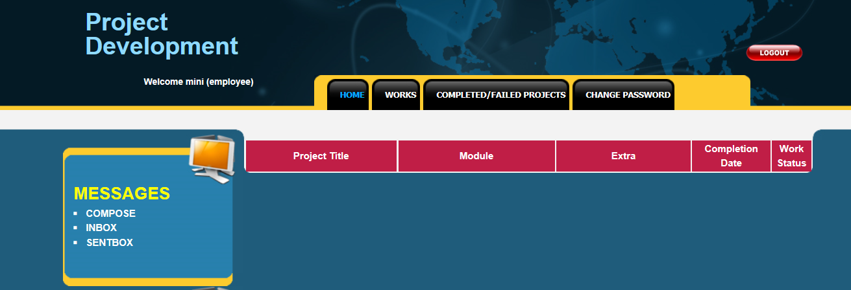
Work View

Slide 47
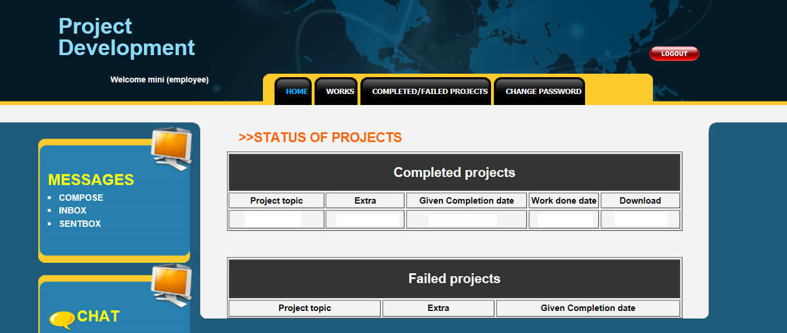
Completed/ Project Failed

